Slide 1


PROBATIONARY PERIOD FINAL REPORT
PROBATIONARY EMPLOYEE
IT / MES SUPPORT
Enterprise Application (EA) Team
PRESENTER
Nguyễn Văn Đức
EVALUATORS
Mr. Jang, Mr. Phi & EA Team

Slide 2






PRESENTATION CONTENT
Actual Work Done
Performance Evaluation
Future Plans
Detailed workload and results of assigned tasks.
Analysis of advantages, challenges, and lessons learned.
Commitment to contribution, development roadmap for the next 6 months.

Slide 3

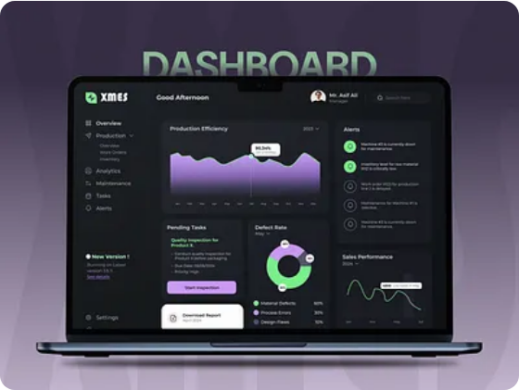
MES & NAIS SYSTEM SUPPORT
Resolution Issue Production
Supported users in resolving daily MES/NAIS errors.
Deep Research: Conducted in-depth research on business flows & Stored Procedures.
On-site Troubleshooting: Troubleshoot issues directly on the production floor: Sorting machine errors, display screen errors.
System Stability: Ensured stable system operation, preventing production line interruptions.

Slide 4
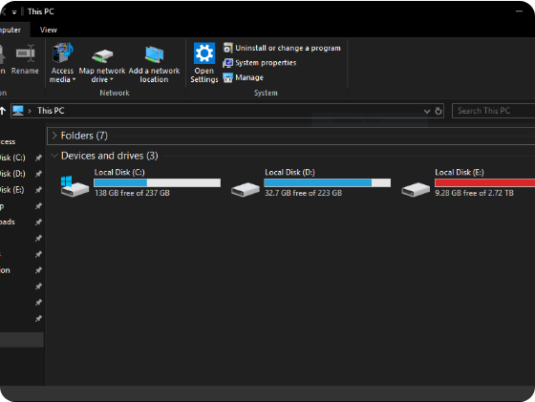
SOFTWARE DEVELOPMENT
Internal Tools & Research
Successfully researched and built the "Excel to Database Import Module" tool.
Feature Deployment: Deployed additional screens on the MES system for other departments.
Team Collaboration: Supported other team members in software design.
System Study: Studied existing company software such as ANDON, Meeting room booking system.

Slide 5






NETWORK INFRASTRUCTURE MANAGEMENT (3 SITES)
Network Troubleshooting
Wi-Fi Configuration
Physical Deployment
Troubleshoot internet errors and signal attenuation at BG1, BG2, and Bac Ninh.
Deployed WPA2-Enterprise, managed SSIDs for production and office use.
Installed Cat6 and COM cables for factory equipment across all 3 facilities.

Slide 6
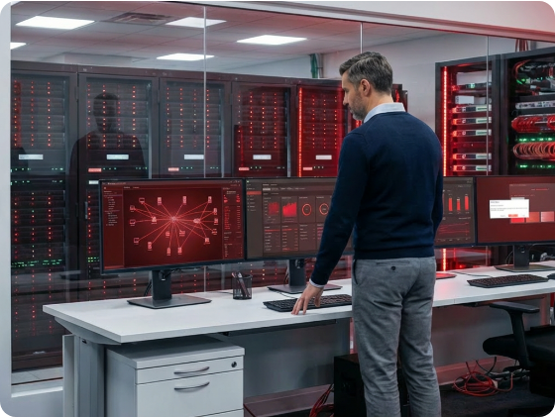
IT HELPDESK & SYSTEM ADMIN
User Technical Support
Installed specialized software (NAIS, ECM…).
Hardware Setup: Set up new kiosks, laptops for new employees, and network connections for other factory equipment.
System Administration: Managed email accounts, configured user permissions, and updated Admin passwords.
Constant Support: Provided continuous technical support for issues arising on the factory floor.

Slide 7
PART 02
PERFORMANCE EVALUATION
Analysis of achieved values and challenges to overcome.

Slide 8



ADVANTAGES & PERSONAL GROWTH
Modern Environment
Hybrid Skills
Team Support
Gained access to high-tech production lines, materializing MES knowledge into practice.
Improved flexible troubleshooting mindset for both network hardware and software coding/Database.
Received dedicated guidance from EA Team seniors for quick integration.

Slide 9



CHALLENGES & DIFFICULTIES
Complex System
Time Pressure
Continuous Relocation
MES has multiple nested modules, requiring significant time for code tracing and thorough resolution.
Issues on the production line require immediate fixing to prevent production downtime.
Multi-site support (BG1, BG2, Bac Ninh) demands excellent time management skills.

Slide 10

SHORT-TERM PLAN (1-3 MONTHS)
Core Objectives
Become a full-time employee, fully master MES Support & Help Desk tasks.
Screen Deployment: Deploy new MES screen: C486 - Sorting Error Excel.
Database Configuration: Modify Stored Procedures & configure Database for new product models.

Slide 11





MID-TERM PLAN (3-6 MONTHS)
Independent Operation
Deep Project Involvement
Automation
Capable of independently handling the entire MES Ticket lifecycle from creation to closure.
Make key contributions to important internal software projects like ANDON and BI Production Plan.
Develop automation tools for daily IT tasks to increase overall team efficiency.

Slide 12

PROPOSALS & Q&A
THANK YOU!
Improvement Recommendations
I look forward to receiving feedback from Mr. Jang, Mr.Phi and the Team.

Slide 13




IMAGE SOURCES
https://cdn.dribbble.com/userupload/46183675/file/0a64adaf19e5c45ae7d528ca142b23ea.png?format=webp&resize=400x300&vertical=center
Source: dribbble.com
https://i.sstatic.net/Jl9Al.png
Source: stackoverflow.com
https://blog-cdn.anydesk.com/posts/019b9c45-edf2-7ef1-9994-21586ed98507/Wake-on-LAN%20header.png
Source: anydesk.com
https://img.freepik.com/free-photo/dynamic-data-visualization-3d_23-2151904311.jpg?semt=ais_hybrid&w=740&q=80
Source: www.freepik.com

